Slide 1
SPIRiT:
Iterative Self-consistent Parallel Imaging Reconstruction from Arbitrary k-Space

Slide 2
1. SPIRiT(Recap)
1.1 Overview
1.2 POCS
2. Implementation
2.1 k-space based CG
2.2 image based CG

Slide 3
1.
SPIRiT

Slide 4



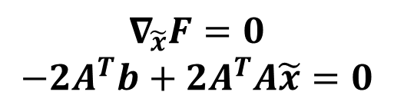


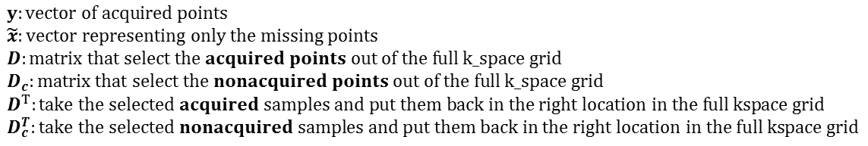
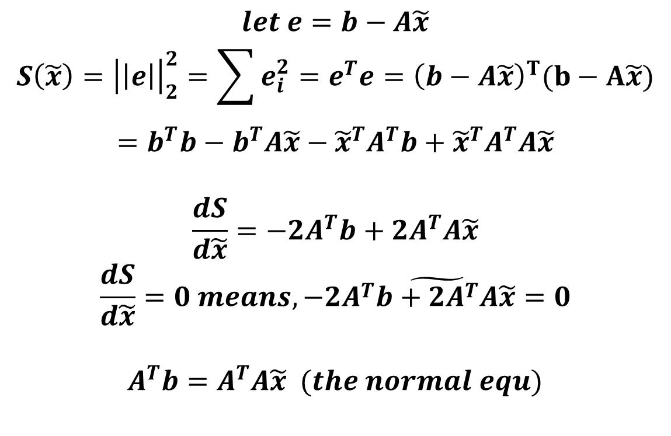
1.1 Overview
$$Cartesian sampling$$
$y:vector of acquired points$
$\tilde{x}:vector representing only the missing points$
$D:matrix that select the acquired points out of the full k_space grid$
$D_{c}:matrix that select the nonacquired points out of the full k_space grid$
$$D^{T}:take the selected acquired samples and put them back in the right location in the full kspace grid$$
$D_{c}^{T}:take the selected nonacquired samples and put them back in the right location in the full kspace grid$
$$let e=b−A\tilde{x}$$
$$S\left(\tilde{x}\right)={\left|\left|e\right|\right|}_{2}^{2}=\sum{e_{i}^{2}}=e^{T}e={\left(b−A\tilde{x}\right)}^{T}(b−A\tilde{x})$$
$$=b^{T}b−b^{T}A\tilde{x}−{\tilde{x}}^{T}A^{T}b+{\tilde{x}}^{T}A^{T}A\tilde{x}$$
$$\frac{dS}{d\tilde{x}}=−2A^{T}b+2A^{T}A\tilde{x}$$
$$\frac{dS}{d\tilde{x}}=0 means, \tilde{−2A^{T}b+2A^{T}A\tilde{x}=0}$$
$$A^{T}b=A^{T}A\tilde{x} (the normal equ)$$
$$F\left(\tilde{x}\right)= argmin_{\tilde{x}}{\left|\left|A\tilde{x}−b\right|\right|}_{2}^{2}, where A=\left(G−I\right)D_{c}^{T}, b=−\left(G−I\right)D^{T}y$$
$$∇_{\tilde{x}}F=−2A^{T}b+2A^{T}A\tilde{x}$$
$$∇_{\tilde{x}}F=0$$
$$−2A^{T}b+2A^{T}A\tilde{x}=0$$
$$\hat{A}\tilde{x}=\hat{b},$$
$$where \hat{A}=D_{c}\left(G^{T}−I\right)\left(G−I\right)D_{c}^{T},$$
$\hat{b}=−D_{c}\left(G^{T}−I\right)\left(G−I\right)D^{T}y$

Slide 5
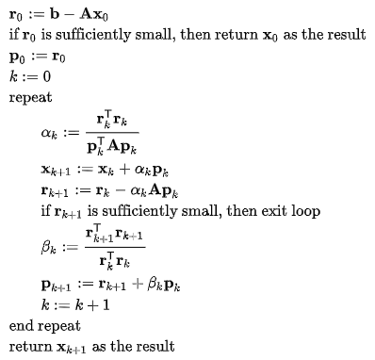


1.1 Overview
$$\hat{A}\tilde{x}=\hat{b},$$
$$where \hat{A}=D_{c}\left(G^{T}−I\right)\left(G−I\right)D_{c}^{T},$$
$\hat{b}=−D_{c}\left(G^{T}−I\right)\left(G−I\right)D^{T}y$

Slide 6
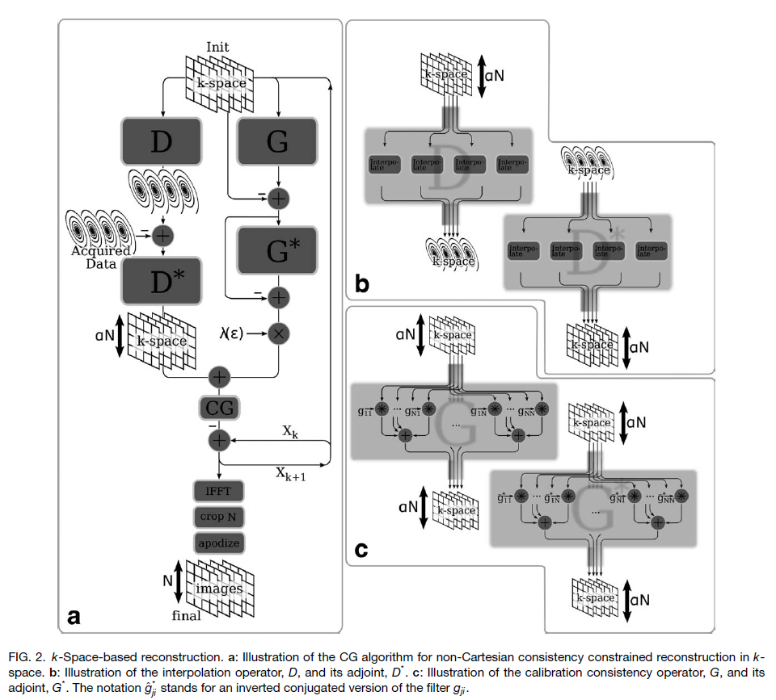
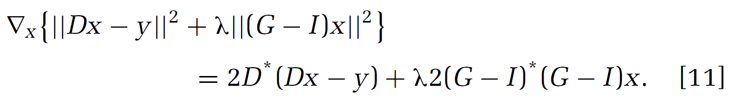
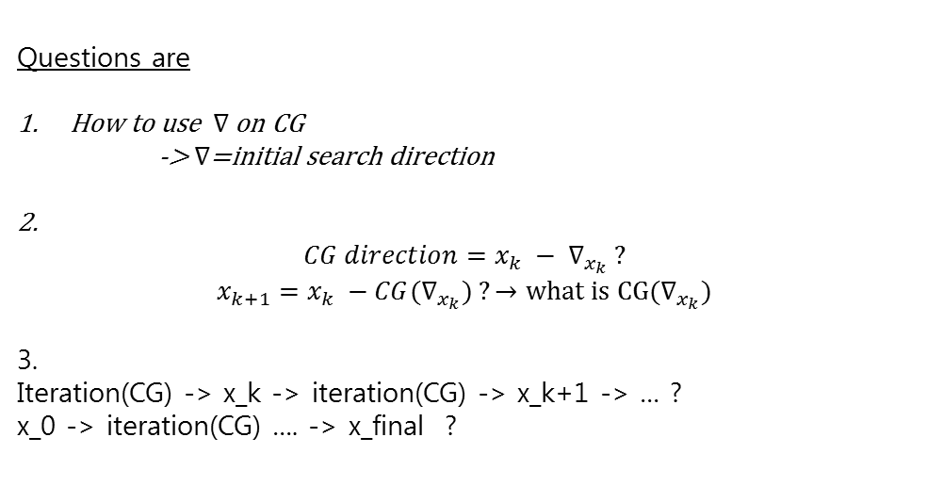
1.1 Overview
(x)
: calculating the gradient of objective function(eq.11)
: acquisition data consistency term (interpolating error)
(y)
: calibration data consistency term
The calculated gradient is then used to find a CG direction, which is subtracted from the previous estimate of k-space.
Questions are
How to use $∇$ on CG
-> $∇$=initial search direction
2.
$${CG direction=x_{k} − ∇}_{x_{k}} ?$$
$${x_{k+1}=x_{k} −CG(∇}_{x_{k}}) ?→what is CG(∇_{x_{k}})$$
3.
Iteration(CG) -> x_k -> iteration(CG) -> x_k+1 -> … ?
x_0 -> iteration(CG) …. -> x_final ?

Slide 7
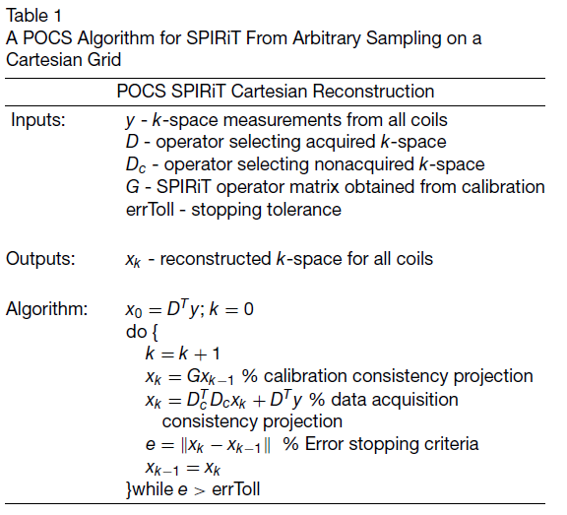


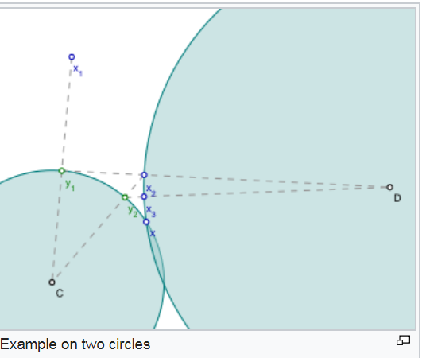
1.2 Projection Over Convex Sets(POCS)

Slide 8
2.
Implementation
Elapsed time :
2.1 k-space based CG : 9-ish
2.2 image based CG : 6-ish

Slide 9
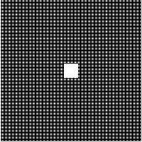
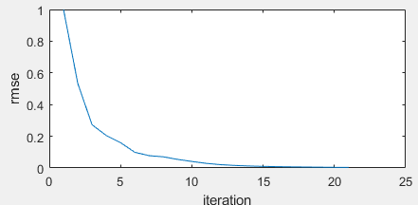
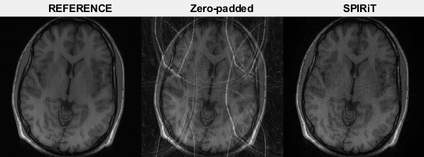
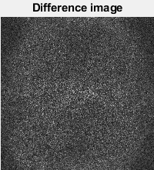
2.1. k-space based CG
Sampling : uniform (x2)
Kernel : [5x5]
Calibration region : [20x20]

Slide 10
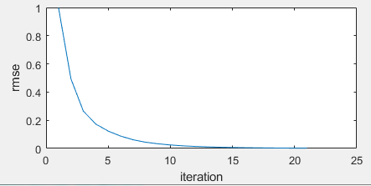
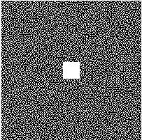
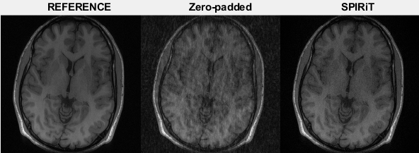
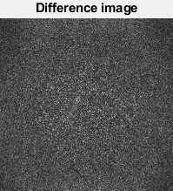
2.1. k-space based CG
Sampling : random(x3)
Kernel : [5x5]
Calibration region : [20x20]

Slide 11
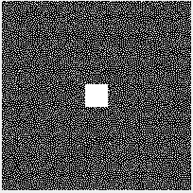
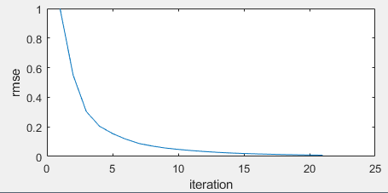
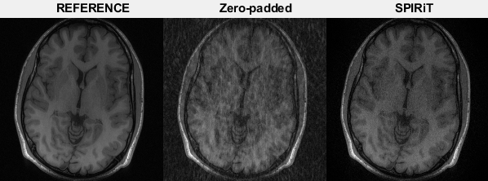

2.1. k-space based CG
Sampling : random (x4)
Kernel : [5x5]
Calibration region : [20x20]

Slide 12
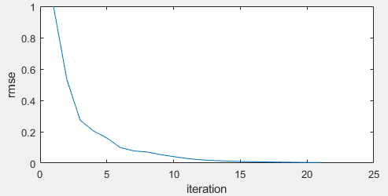
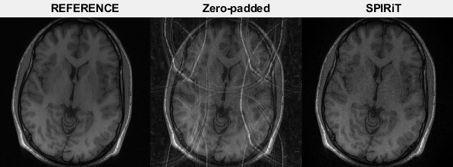
2.2. image based CG
Sampling : uniform (x2)
Kernel : [5x5]
Calibration region : [20x20]

Slide 13
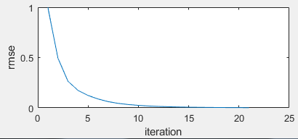
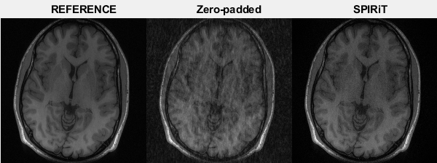

2.2. image based CG
Sampling : random(x3)
Kernel : [5x5]
Calibration region : [20x20]

Slide 14
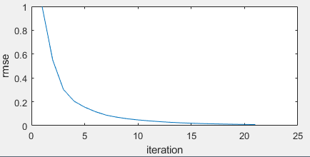

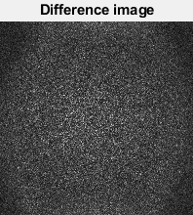
2.2. image based CG
Sampling : random(x4)
Kernel : [5x5]
Calibration region : [20x20]

